Slide 1
Designing and Implementing a Science, Technology and Innovation (STI) Policy in a Developing Country Context: Recent Experience from Nigeria.
Willie Owolabi Siyanbola PhD (Sussex).
Wale Olaopa and Wunmi Hassan
National Centre for Technology Management (NACETEM),
An Agency of the Federal Ministry of Science & Technology (FMST),
Obafemi Awolowo University, Ile-Ife, Nigeria
A paper delivered at:
Triple Helix 10th International Conference 2012 Held between 8-10 August 2012
At Grand Royal Panghegar, Bandung, West Java, Indonesia

Slide 2
OUTLINE
Acknowledgement
STI and Socio-economic development
STI development Landscape in Nigeria: How far and how well?
Highlights of the new STI policy: What is new?
Some challenges and the lessons learnt
Concluding Remarks

Slide 3
Acknowledgement
LOC, Triple Helix Conference, 2012
Federal Ministry of Science and Technology, Nigeria.
NACETEM’s STI Policy Review Team, Consultants and other key Stakeholders

Slide 4
PREAMBLE

Slide 5
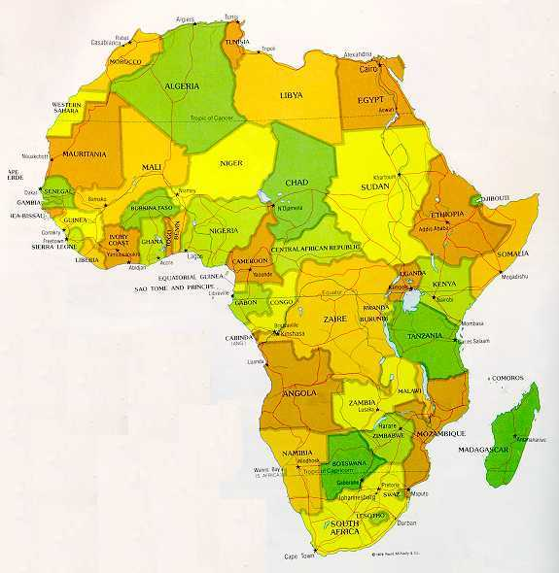
Facts on Nigeria
Nigeria – Some fact file
Political Independence: 1960
Population: Est. 150 million (2008)
Land area 923,000 sq km
Governance Structure: Presidential System
No of States: 36 + FCT
Economy
6th largest oil producer (OPEC)
GDP per capita: US$ 2400 (2010)
Literacy: 80% (2008)
Telecom Subscribers: 110million (Dec 2010)
Tele-density: 63% (Dec. 2010)
External reserves: US$37b (2010)
Consumer Inflation: 11.8% (2010)
Unemployment: 19.7% (2009)

Slide 6
STI and Socio-economic Development
The vital role of STI in socio-economic development is acknowledged the world over.
The more industrialized countries of the world applied S&T to develop their economies.
Brazil, Russia, India, China and South Africa (BRICS) and a few other countries, followed suit and have also successfully applied STI to transform their economies.

Slide 7
STI and Socio-economic Development
What gives a Nation/State competitive edge is not just its natural endowments, but how much (STI ) knowledge it has, how it uses the knowledge, and how quickly it can learn new knowledge.
Today, developments in STI are not only important determinants of country’s level of development but also enhance its international competitiveness.

Slide 8
Historical Landscape

Slide 9
S&T development landscape in Nigeria
In Nigeria, various Governments, since independence, have shown interest and increasing appreciation and understanding of the critical role of S&T on the national political and socio-economic development programmes.
Government have at various times made efforts at establishing structures and formulating policies to mobilize S&T for rapid national development.
N.B.
Bold and deserving but these efforts have had limited success.

Slide 10
STI Landscape in Nigeria since Independence
Period | Characteristics | Initiatives
1960 – 1965 | Agarian Based Economy Initial post-independence era with national aspirations for rapid socio-economic development | Establishment of few research centres in agriculture, medicine and industrial research: Cocoa Research Institute (1964) Nigeria Institute for Trypanosomiasis (1964), Nigeria Institute for Oil Palm Research (1964), Medical Research Council (1962) Establishment of new Universities in Ife, Zaria, Lagos and Nsukka in addition to the University of Ibadan and few Colleges of Technology
1966 – 1971 | Civil war period | Appointment of a UNESCO expert by FGN to serve as adviser on S&T Policy formulation -1966 Promulgation of Decree 7(No. 83) that established Nigeria Council for Scientific and Industrial Research (NCSIR) - 1966 Establishment of Nigeria Council for Science and Technology (NCST) in 1970
1972 - 1980 | Oil boom era | Establishment of the National Science and Technology Development Agency (NSTDA) in 1977 to replace NCST Establishment of full-fledged Federal Ministry of Science and Technology (FMST) in 1979 Establishment of NAEC 22 Research Institutes had been established Centre of Excellence (COEs) Approval for establishment of 7 universities of technology

Slide 11
STI Landscape in Nigeria since Independence contd.
Period | Characteristics | Initiatives
1980 –1992 | Instability in national governance of S&T | FMST was Merged with Education - 1984 FMST demerged from Education -1985 1st National Science and Technology Policy in Nigeria produced in 1986 S&T policy was approved by Govt. (1988) and Implementation framework produced (1987) Scrapping of FMST- 1992 Establishment of National Agency for Science and Engineering Infrastructure (NASENI) in 1992 to replace FMST
1993 –1998 | Political Instability | Re-establishment of FMST in 1993 2nd S&T Policy formulated in 1997(1st revision)
1999 –2012 | Return to Democracy Stability in S&T Administration | S&T Policy revision attempted in 2001 2nd S&T Policy revision in 2003 Establishment of NITDA, NABDA, NASDRA Reform of STI System (2005 – 2008) New STI Policy developed by FMST in 2012

Slide 12
STI Policy Design and Implementation:
1986 - 2012

Slide 13
Previous Efforts at STI Design: 1986 – 2012.
Policy documents | Features/initiatives | Inadequacies/limitations
The first S&T Policy (1986) | It was designed to create harmony in the pursuit of knowledge about the country’s environment through research and development (R&D). | The Ministry, after about 10 years of its inconsistent implementation, saw the need to incorporate new developments areas in S&T.
1st Policy Revision (1997) | 1997 revised policy was aimed at creating an independent, integrated and self-sustaining economy. It gave prominent considerations to: Coordination and management of S&T system; Sectoral developments (Agriculture, Health, Industry and Commerce, Energy, Information Technology, Environment, Defence and Security, etc). | It failed to address the institutional frameworks that should foster interaction among the various elements of the National System of Innovation (NSI).

Slide 14
Previous Efforts at STI Design: 1986 – 2012.
Policy documents | Features/initiatives | Inadequacies/limitations
2nd Revision (2003) | The revision adopted a programmatic approach to policy making and emphasized the need for a coherent, systematic and comprehensive determination of technological programmes. Focused on new/emerging technologies including biotechnology, energy and environment, ICT, Nanotechnology, materials science/engineering etc. | The ‘policy’ document was seen as a compendium of key S&T sub- sectoral policies, voluminous, and inadequately to attend to the issue of S&T culture and the harmonisation of S&T policy with other socioeconomic policies.

Slide 15
STI Policy and Technology development in Nigeria
Despite various efforts at policy formulation, the national S&T system continues to suffer major weaknesses and constraints as reflected by:
    Poor policy implementation due to ineffective policy instruments;
    the general lack of visible impacts arising from weak integration of S&T into national socio-economic policies and development planning processes;
    Lack of institutional and legal frameworks
    Inadequate promotion of S&T culture
    Limited use of relevant STI statistics for policy formulation
    Weak capacity and weak R&D base due to poor state of infrastructure and
    Inadequate funding to support STI activities.
    Limited stakeholders’ participation and policy ownership is almost non-existent.

Slide 16
The new STI Policy:
Design and Implementation Framework
- Why and how?
- challenges
- Lessons Learnt

Slide 17
Why a New STI Policy?
The need to:
develop a more concise, robust and workable STI policy given the dictates of globalization, changing business environment and new/emerging technologies.
For S&T to translate to improved quality of life, it must be focused at bringing new goods and services to the market - INNOVATION
integrate ‘innovation’ (a global S&T tool for fast-tracking sustainable industrial development)
Shift in focus from knowledge generation to utilisation (Promote Technology Entrepreneurship)
Provide evidence-based policy by leveraging on POLICY research outcomes including especially, R&D and Innovation Surveys in line with global best practices
Integrate STI policy with the National Blueprint.

Slide 18
Methodology

Slide 19
An all-inclusive participatory approach was adopted which included:
  Establishment of a review team consisting of experts and consultants
  Critical analyses of S&T policies of over twenty-five (25) countries;
  Analysis of Nigeria’s existing and related documents particularly - Economic Summit Group and the 2005 Nigeria/UNESCO STI reform project;

Slide 20
Methodology contd.
Creation of platforms for national discourses on the extant S&T policy under review;
Active engagement of various stakeholders within the Nigeria’s NSI as well as experts and development partners at different meetings to peruse the draft STI policy.

Slide 21
How it was done:
Methodology for Accomplishing the Objectives.
Nigeria’s STI Policy
Final STI Policy
FEC Approval
Decide Who does What?
Implementation Framework/Action Plan
Design of New STI Policy
Draft STI Policy
Industry, Academia, Military, NUC, National Assembly, Cognate Ministries
Stakeholders’ Consultative Forum
Reform Reports, Interaction of NIS & recent Govt. Initiatives
Identification of Key S&T Issues
India, Brazil, South Africa, Chile, Vietnam, Singapore & Malaysia
Country’s S&T Policies Review
Compilation of how best to design a workable STI Policy
Identification of Global Best Practices in Policy Making
Performance Review and Identification of Gaps
Review of Extant S&T Policies in Nigeria

Slide 22

Vision, Objectives and Strategies
Facilitate the acquisition of knowledge to adapt, utilise, replicate and diffuse technologies
Strategies
National VISION 20-2020
Carry out R&D in all relevant S&T areas
Support the establishment and strengthening of organisations, institutions and structures
Institutional & Legal Frameworks and Governance
Encourage and promote creation of innovative enterprises utilising Nigeria’s indigenous knowledge and technology
The R&D areas, Intellectual Property and Technology Transfer & Diffusion in STI
STI POLICY MISSION
Support mechanisms to harness, promote, commercialise and diffuse locally developed technologies
Raw Materials Research and Technology Transfer & Diffusion in STI
Facilitate the creation and maintenance of up-to-date, reliable and accessible database on Nigeria’s STI resources
General Objective
STI Information Management
Promote activities for effective STI communication and inculcation of STI culture in Nigerians
STI Promotion and Human Resource Development
8 Specific Objectives
Create and sustain reliable mechanisms for adequate funding of STI activities in Nigeria
Funding STI
Initiate, support and strengthen strategic bilateral and multilateral co-operations in scientific, technological and innovation activities
STI Partnership and Collaborations

Slide 23
The New National STI Policy
Equity and inclusiveness | Transparency and accountability | Efficiency and effectiveness
i. adoption of the bottom-up and the democratic approaches. ii. Promoting effective linkages and collaborations among all stakeholders engaged in STI activities. iii. Encouraging the joint ownership of the policy through incorporation of stakeholders’ inputs. iv. Encouraging integration of STI culture with other socioeconomic policies. v. initiating, supporting and strengthening strategic bilateral and multilateral co-operations in scientific, technological and innovation activities | i. creating the needed awareness on the revised Policy. ii. Developing an appropriate mechanism for the sourcing, allocation and managing of STI fund. iii. Strengthening the various governance structure through effective allocation of function, delineation of authority and provision of resources. iv. Facilitating the documentation and dissemination of STI priorities, research and funding. | i. Setting-up and developing R&D according to national priorities and deploying capabilities in the management of R&D and STI governance structure. ii. Examining the adequacy or otherwise of the various components of the existing S&T policies. iii. Developing capacity to monitor, predict and mitigate adverse effects of the policy through effective strategies and implementation plan. iv. Promoting design and implementation through the utilisation of STI indicators. v. Promoting ethics and standards in research for STI sustainability.

Slide 24
Challenges to the of Review Process and solutions
Leadership / political will
Resource allocation to STI activities
Competition rather than complementary efforts on the part of cognate Ministries, Departments and Agencies (MDA)
Lack of agreement in the centrality of STI policy to other sectoral policies exemplified by the non-inclusion of S&T in the National Economic Team.
R&D Coordination (who should be in-charge?)

Slide 25
How the challenges were resolved: Lessons for other developing countries.
Leadership to be provided by the presidency at the national level while state governors are responsible at the at the state level.
Bottom-up rather than top down – all inclusive and participatory approach
Advocacy for executive/ legislative supports through sensitization workshops
Use of STI indicators and relevant statistics in the policy design (critical)
Articulation of performance monitoring and evaluation Indicators
Full or Near-full integration with the national development vision and agenda
Workable implementation framework accompanied the document.

Slide 26


Highlights of the New National STI Policy
The New STI Policy articulates
R&D Priority Settings
S&T Administration & Governance –
Robust coordination of R&D
(NRIC)
Reliable Funding Mechanism
(NRIF)
Collaborative Engagement of Development partners
(Strategic Alliance and Networking)
Public-Private –Partnership
(Triple Helix Approach – G-I-A Model)
Promote Technology Entrepreneurship & R&D Commercialisation) by initiating Venture Capital
N.B: All of the above will have wide ranging implications
for Tech. Advancement and Nigeria’s Economic Development in the next decade

Slide 27
Concluding Remarks

Slide 28
Concluding Remarks
The new Nigeria’s STI policy acknowledged the critical role of innovation as a tool to fast-tract national technological advancement and industrial competitiveness.
The policy unlike any previous one adopted an all inclusive, bottom-up approach to endanger widespread stakeholders’ participation and ownership aimed at mustering adequate support for the policy and hence its effective implementation.

Slide 29
Concluding Remarks contd.
Its full integration into the national economic development blueprint provided by Mr. President coupled with the initiation of reliable funding mechanisms, and strategic partnership with international development partners as well as Public-Private sectors support would ensure considerable impact of the policy on the quality of life of the citizenry.
Above all, for maximum impact of the policy, the FMST, other key actors and stakeholders must continue to embark on strategic popularization, sensitization and advocacy to all levels of government as well as the business sector.

Slide 30
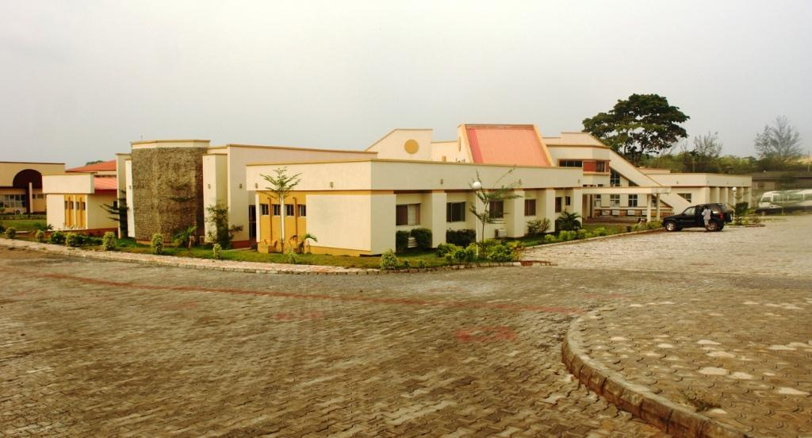
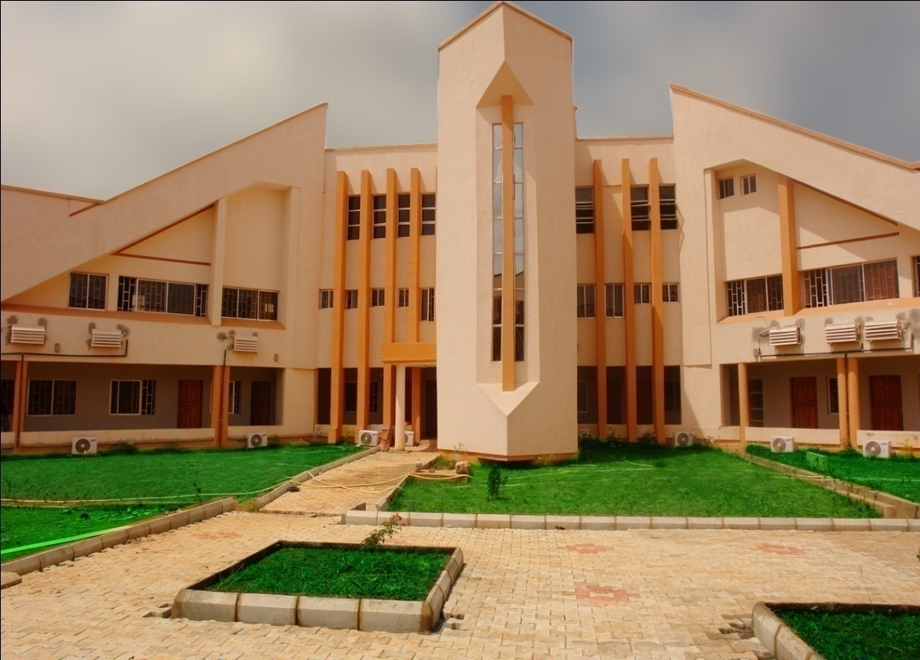

at a Glance

Slide 31

THANK YOU
FOR YOUR
ATTENTION
Please visit:
www.nacetem.org

